Slide 1
Artificial Intelligence Engineer Introduction to Python for AI/ML A Beginners Guide – Part 2
Dr. Nuwan Kodagoda
Head/Department of Computer Science and Software Engineering
Faculty of Computing
SLIIT

Slide 2
Learning Outcomes
Be able to use the following
Lists, Tuples, Dictionaries
NumPy, Matplotlib libraries
Using Modules and Classes
Jupiter Notebook, Google Colab

Slide 3
Lists and Tuples
Lists and Tuples are collection data types, that allow you store multiple items in a single variable.
You can have data of different types in lists and tuples.
xlist = ["apple", "banana", "berry", 45, 56.7, True]
xtuple = ("apple", "banana", "berry", 45, 56.7, True)
The only difference in Lists and Tuples is the fact that Lists are mutable and Tuples are imutable.

Slide 4
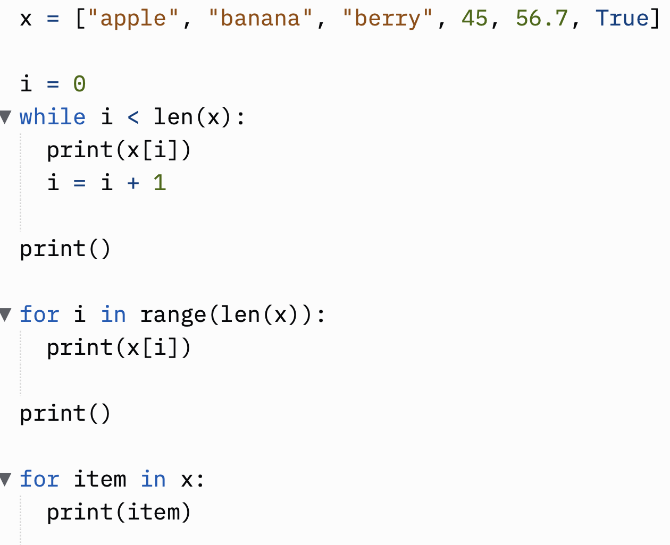
Iterating elements in a collection data type

Slide 5
Collection types slicing
Collection[start : end : step]
Extracts a sub collection starting from index start to index end-1 taking increments of step
The extracted elements will satisfy the following conditions, the indexes will be
>= start
< end
Increments of step
0
1
2
3
4
5

Slide 6
Dictionaries
Dictionaries are used to store key, value pairs
Each key in a dictionary is unique, and value can be any data type including any collection types
x = {"id" : 100, "name" : "Saman", "salary" : 50000.0}
key
value
x["id"]
x["name"]
x[”salary"]

Slide 7
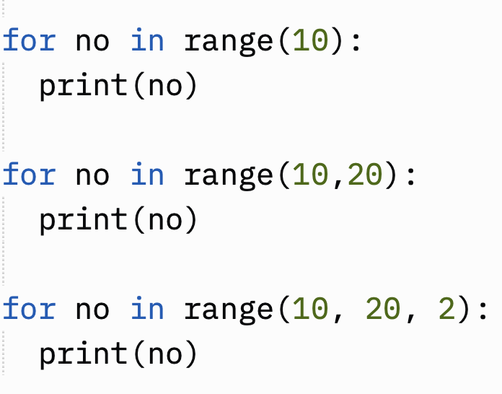
Range
Used to create a range of numbers.
We can use this generate numbers that can be part of a counter in a for loop
0 1 2 3 4 5 6 7 8 9
10 11 12 13 14 15 16 17 18 19
10 12 14 16 18

Slide 8
NumPy
NumPy is the fundamental package for scientific computing in Python.
It is a Python library that provides a multidimensional array objects.
Arrays are collections where the data type of all elements are the same.
In python we can do direct array based calculations unlike other programming languages.

Slide 9
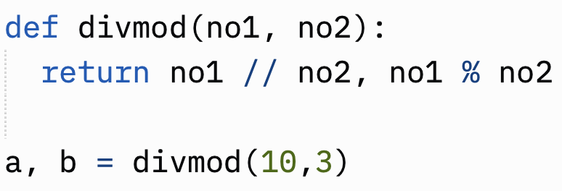
Functions returning multiple values

Slide 10
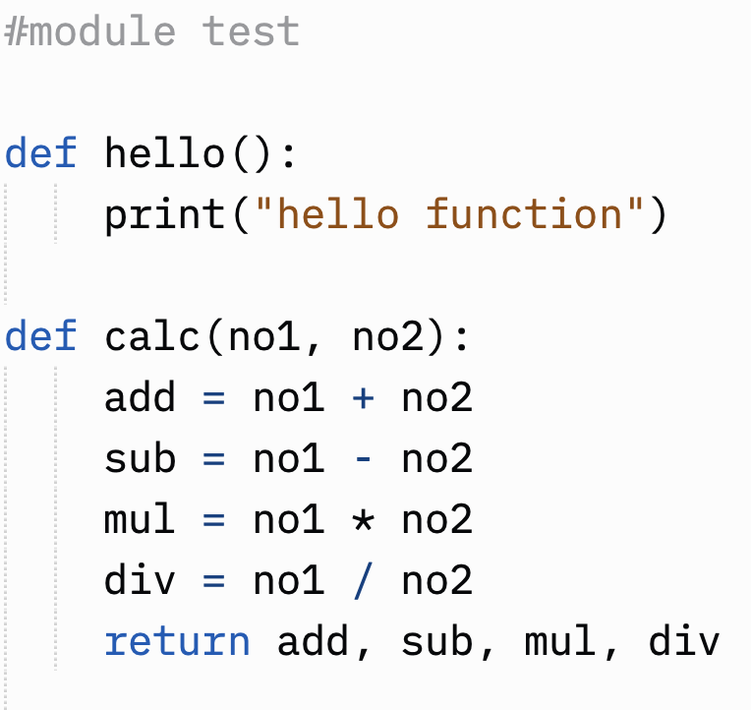
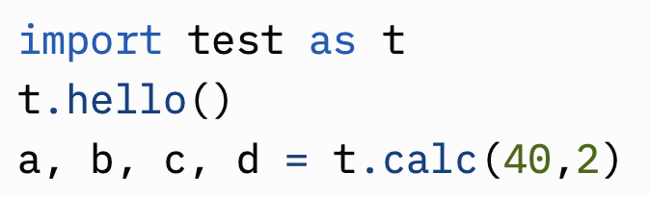
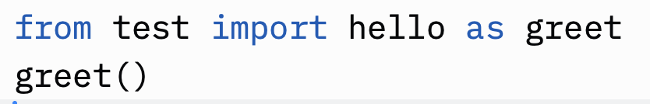
Using Modules
test.py

Slide 11
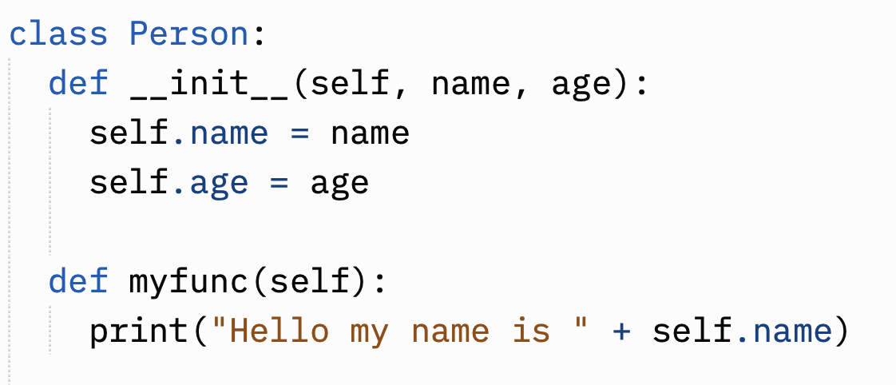
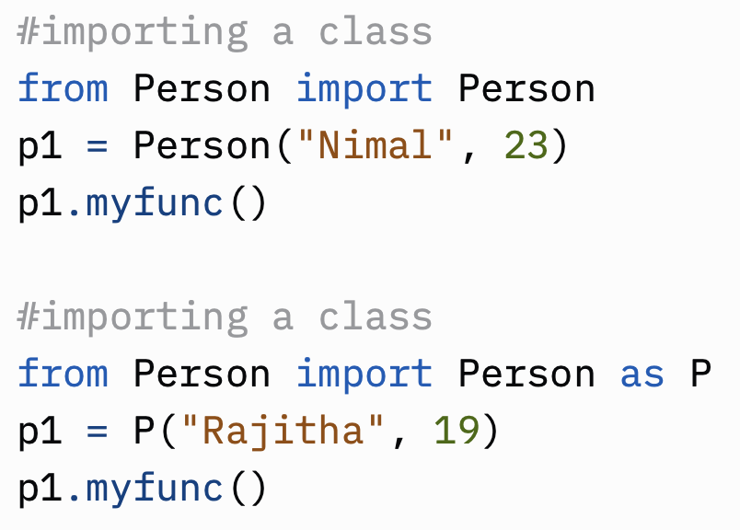
Using Objects

Slide 12
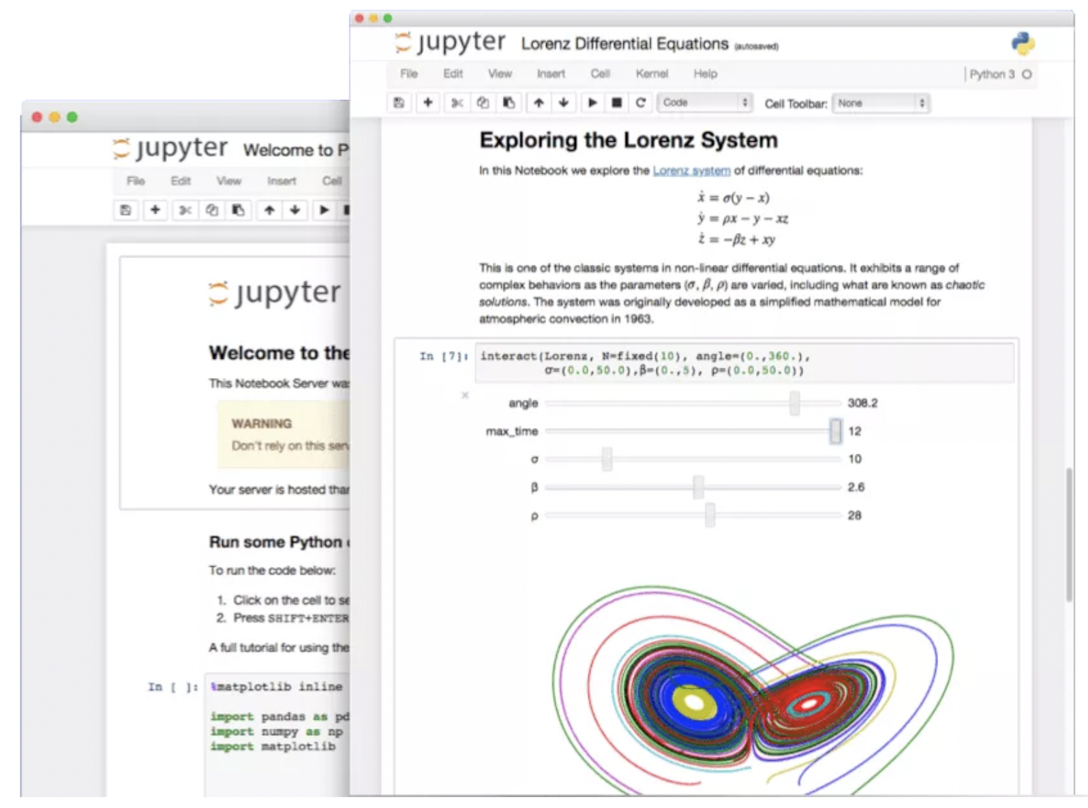
Using Jupiter Notebooks
These are computational documents where you can develop interactive content.
Mix markdown based documentation text and python code in one integrated document.

Slide 13
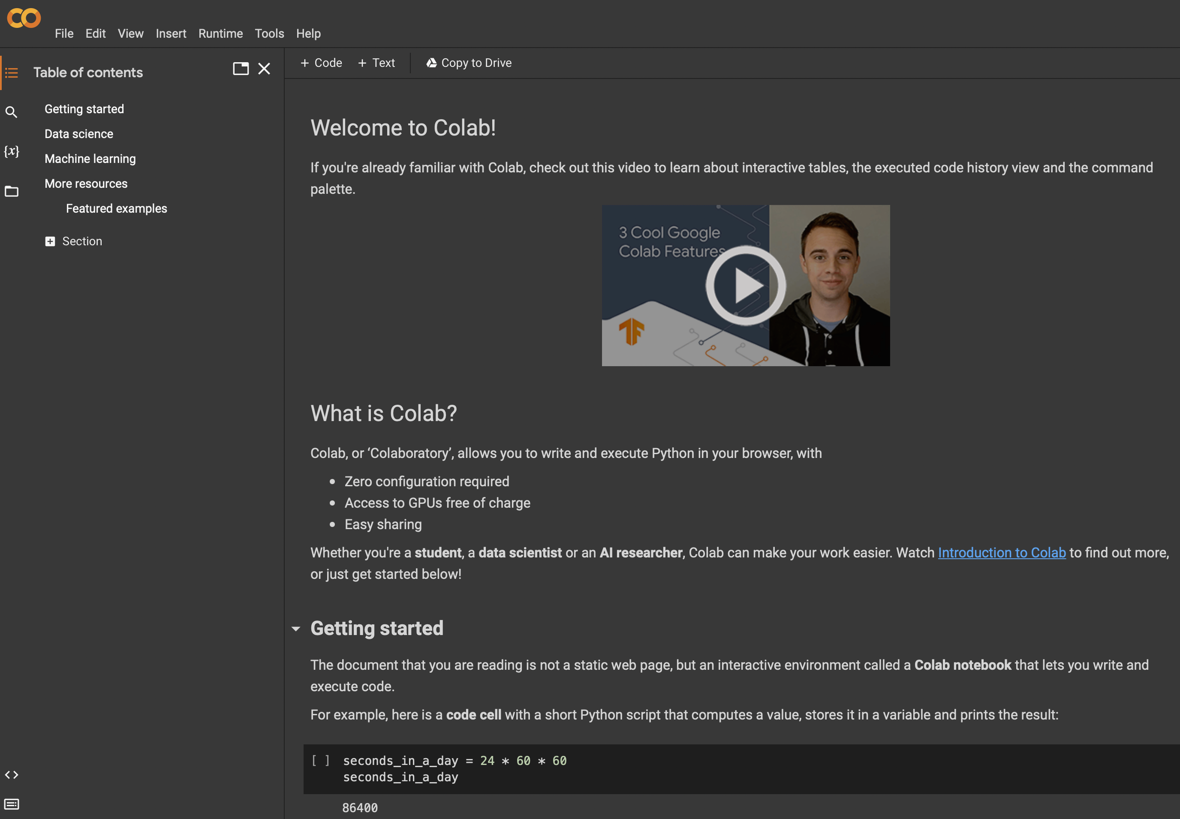
Using Google Colab
Colab, or ‘Colaboratory’, allows you to write and execute Python in your browser, with
Zero configuration required
Access to GPUs free of charge
Easy sharing
Compatible with Jupiter Notebooks

Slide 14
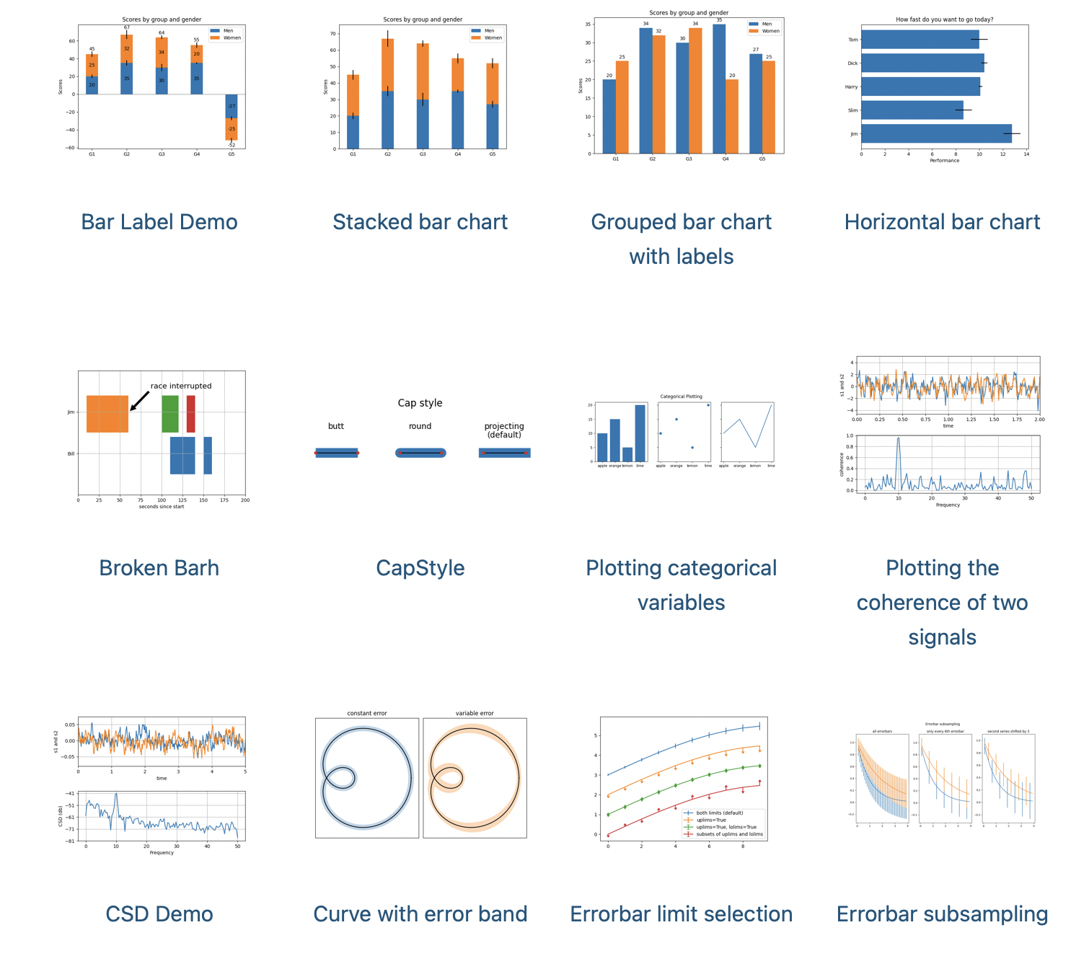
Using MathplotLib
Matplotlib is one of the most popular Python packages used for data visualization.
It is a cross-platform library for making 2D plots from data in arrays.

Slide 15
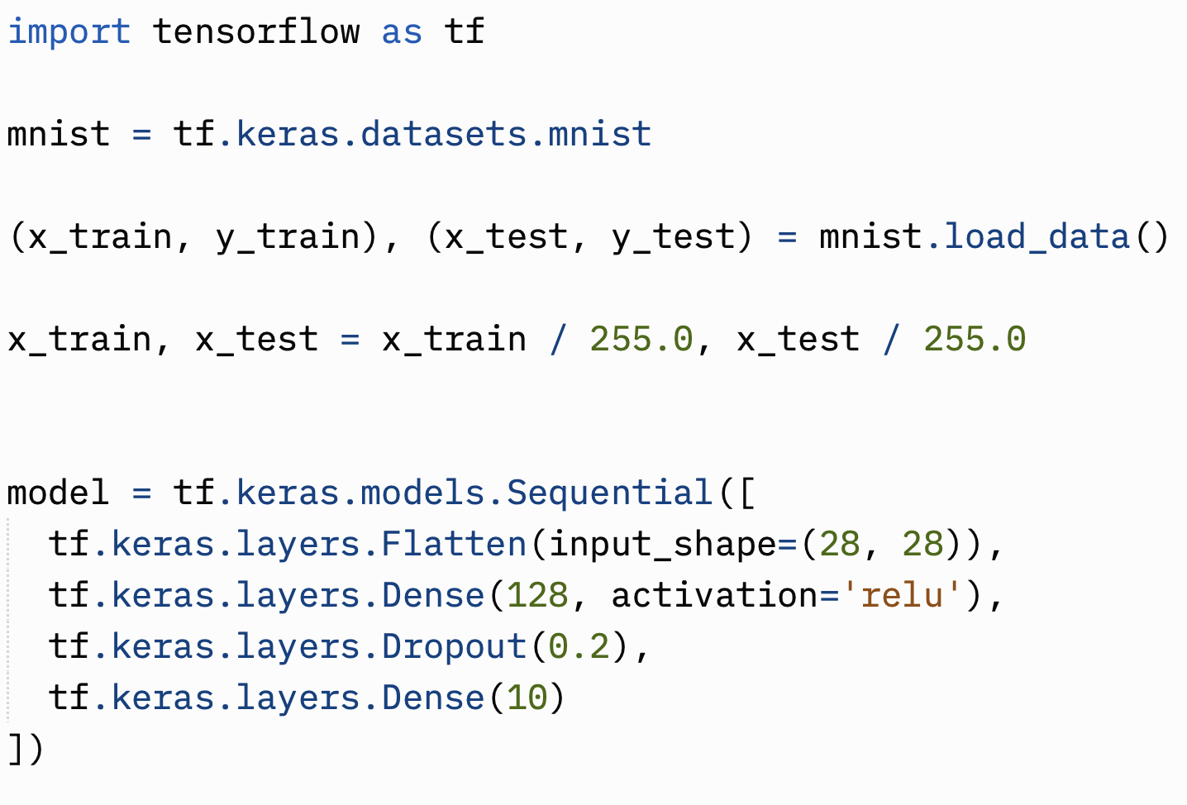
e.g. TensorFlow Libraries

